Slide 1

Inheritance
Algorithms

Slide 2
Inheritance
Banyak objek dalam dunia nyata memiliki hubungan secara hirarki dengan objek lainnya. Sehingga objek yang dibawahnya memiliki karakteristik yang sama dengan objek diatasnya.
Contoh:
Mamalia → primata → orangutan
Kendaraan → mobil → Honda Accord

Slide 3
Inheritance
Konsep menurunkan sebuah kelas ke kelas lainnya, biasanya terdapat dalam sebuah hirarki.
Superclass
Subclass
Reusability

Slide 4
Mengapa menggunakan Inheritance
Reuse of code.
Metode yang ditentukan di parent disediakan untuk child tanpa perlu ditulis ulang sehingga memudahkan pembuatan abstraksi baru.
Reuse of concept.
Metode yang dijelaskan di parent dapat didefinisikan ulang dan diganti di child class. Meskipun tidak ada kode yang dibagikan antara parent dan child, konsep yang terkandung dalam definisi tersebut sudah terbagikan.

Slide 5
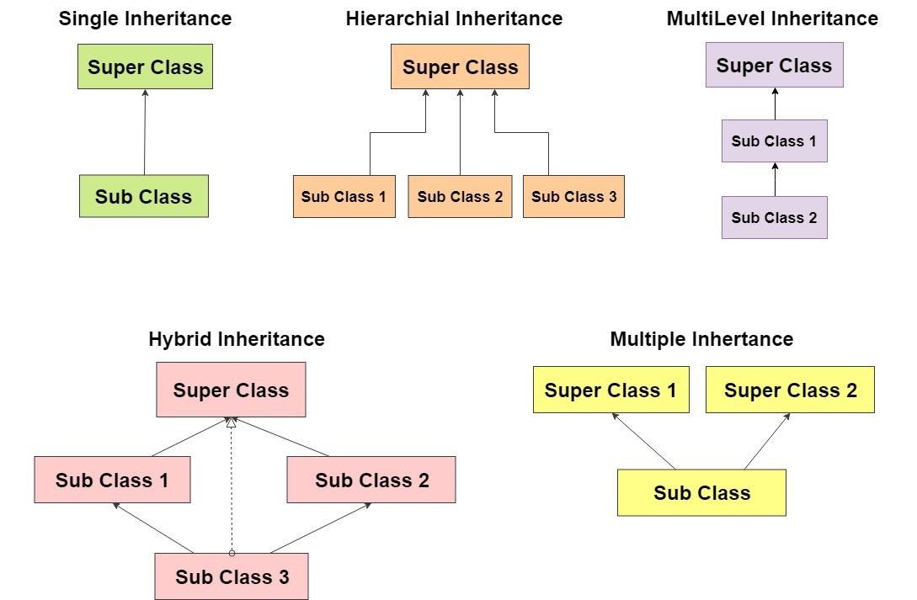
Jenis-jenis Inheritance

Slide 6
Deskripsi Praktis
Data members in the parent are part of the child
Behavior defined in the parent are part of the child
Note that private aspects of the parent are part of the child but are not accessible within the child class.

Slide 7
Contoh Kasus
A university community has thousands of members, including employees, students and alumni.
Employees are either faculty or staff members.
Faculty members are either administrators (e.g., deans and department chairpersons) or teachers.
The hierarchy could contain many other classes. For example, students can be graduate or undergraduate students.
Undergraduate students can be freshmen, sophomores, juniors or seniors.

Slide 8
Contoh Kasus

Slide 9
The Is-A Rule
Our idealization of inheritance is captured in a simple rule-of-thumb.
Try forming the English sentences “An A is-a B”. If it “sounds right” to your ear, then A can be made a subclass of B.
A dog is-a mammal, and therefore a dog inherits from mammal
A car is-a engine sounds wrong, and therefore inheritance is not natual. but a car has-a engine.

Slide 10
Sintaks yang Digunakan
class Wall : public GraphicalObject -- c++
class Wall extends GraphicalObject -- Java
class Wall : GraphicalObject -- C#
type Wall = object (GraphicalObject) -- Object Pascal
class Wall < GraphicalObject -- Ruby

Slide 11
Method Overriding
A subclass inherits all the member variables and methods from its superclasses (the immediate parent and all its ancestors).
It can use the inherited methods and variables as they are.
It may also override an inherited method by providing its own version or hide an inherited variable by defining a variable of the same name.

Slide 12
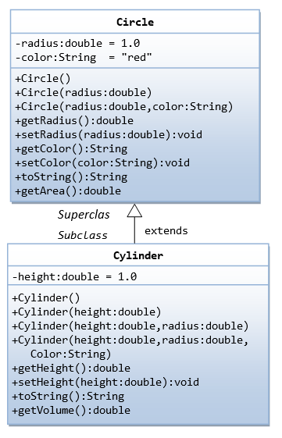
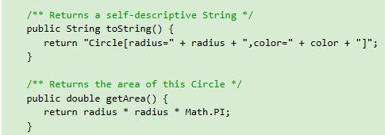
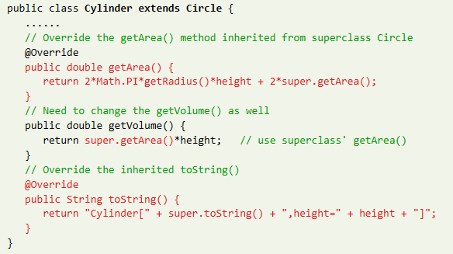
Method Overriding

Slide 13
Method Overriding
The "@Override" is known as annotation (introduced in JDK 1.5), which asks compiler to check whether there is such a method in the superclass to be overridden.
@Override annotation is optional, but certainly nice to have.

Slide 14
Method Overriding
The keyword “super” allows the subclass to access superclass' methods and variables within the subclass' definition.

Slide 15
Keunggulan Inheritance
Software Reuse
Code Sharing
Improved Reliability
Consistency of Interface
Rapid Prototyping
Polymorphism
Information Hiding

Slide 16
Polymorphism
Polymorphous: Having, or assuming, various forms, characters, or styles.
From greek routes, poly = many, and Morphos = form (Morphus was the greek god of sleep, who could assume many forms, and from which we derive the name Morphine, among other things).
A polymorphic compound can crystalize in many forms, such as carbon, which can be graphite, diamonds, or fullerenes.
In programming languages, used for a variety of different mechanisms.
Usage of the term is confused by the fact that it means something slightly different in the functional programming community than it does in the OO world.)

Slide 17
Polymorphism
A subclass possesses all the attributes and operations of its superclass (because a subclass inherited all attributes and operations from its superclass).
This means that a subclass object can do whatever its superclass can do.
As a result, we can substitute a subclass instance when a superclass instance is expected, and everything shall work fine. This is called substitutability.

Slide 18
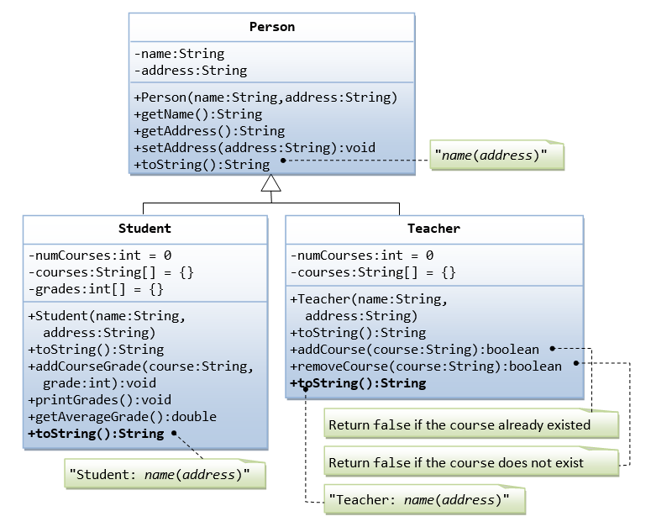
Polymorphism
Saat sebuah superclass didefinisikan sebagai subclass.
Contoh:
Student S1 = new Student();
Teacher T1 = new Teacher();
Person P1 = new Person();
Person P2 = new Student();
Person P3 = new Teacher();

Slide 19
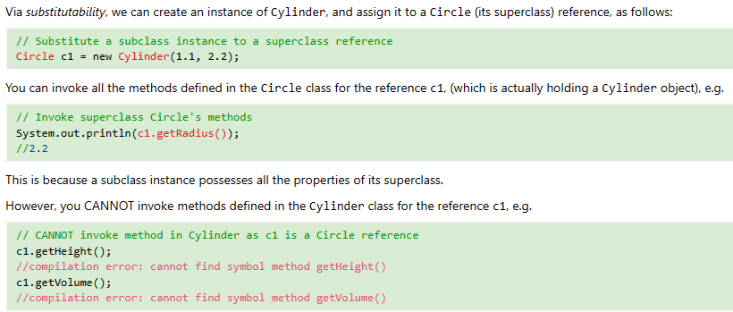
Polymorphism

Slide 20
Upcasting & Downcasting
Substituting a subclass instance for its superclass is called "upcasting". This is because, in a UML class diagram, subclass is often drawn below its superclass. Upcasting is always safe because a subclass instance possesses all the properties of its superclass and can do whatever its superclass can do. The compiler checks for valid upcasting and issues error "incompatible types" otherwise.

Slide 21
Upcasting & Downcasting
Substituting a subclass instance for its superclass is called "upcasting". This is because, in a UML class diagram, subclass is often drawn below its superclass. Upcasting is always safe because a subclass instance possesses all the properties of its superclass and can do whatever its superclass can do. The compiler checks for valid upcasting and issues error "incompatible types" otherwise.

Slide 22
Upcasting & Downcasting
Downcasting is revert a substituted instance back to a subclass reference.
Downcasting requires explicit type casting operator in the form of prefix operator (new-type). Downcasting is not always safe, and throws a runtime ClassCastException if the instance to be downcasted does not belong to the correct subclass. A subclass object can be substituted for its superclass, but the reverse is not true.

Slide 23
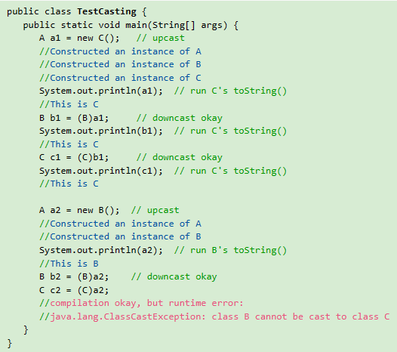
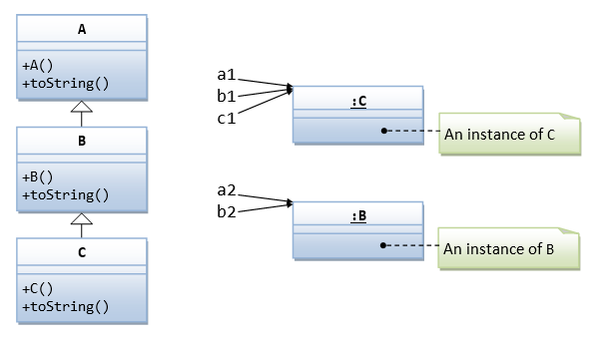
Upcasting & Downcasting

Slide 24
Selesai

